Slide 1
Phosphorus Extraction Technologies
WE Toffey 23 March 2020

Slide 2
Shout Out to Tradition
Class B cake to farms: This is low cost, proven approach to phosphorus recycling
Class A biosolids-derived products: Compost and heat-dried pellets are marketable P-rich products for soil improvement and plant fertilization

Slide 3
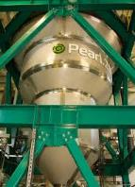
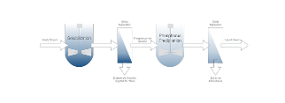
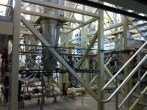
Challenge: Nutrient Balance
The balance of N and P in biosolids is agronomically wrong. The engineering challenge of the day is to extract phosphorus and to retain nitrogen in the biosolids. We are still waiting for the right combination of technologies…
CNP AirPrex in Berlin
Ostara’s Pearl Process
Renewable Nutrients QuickWash

Slide 4
Drivers for P Extraction
Meet effluent discharge standards
Reduce struvite mineralization of equipment
Improve the dewaterability of Bio-P sludges (higher % solids, lower polymer usage)
Recover marketable P fertilizer
Improve N to P ratio in biosolids product
Achieve local and global sustainability goals

Slide 5
Starting Point: How You Meet Effluent Discharge Standards
Enhanced Biological Phosphorus Removal
Phosphorus Accumulating Organisms (PAO) release extracellular polymeric substances (EPS) with highly soluble phosphorus under stress
EPS interferes with dewatering
Dewatering releases soluble P into filtrate/centrate
P in biosolids highly soluble and leachable
Chemical Phosphorus Removal
Use iron or aluminum salts to precipitate phosphorus as an insoluble mineral, incorporated into biosolids
Iron adds to biosolids mass, but aids dewaterability
Iron bound P will not solubilize and cannot be extracted from biosolids

Slide 6
Ending Point: How You Use Biosolids Resources
Landfill disposal: Biosolids-borne P “lost to agriculture” forever
Agricultural land spreading: Biosolids-borne P can build up soil to high concentrations after repeated applications
Land restoration: Biosolids-borne P restores missing P
Incineration: Generally landfilled, but P value can be used.

Slide 7
P Treatment Approaches
Controlled chemical precipitation to avoid struvite build up within treatment plant
Sidestream precipitation as struvite after dewatering
Precipitation of P mineral post digestion, but before dewatering
Precipitation of P mineral pre-digestion.

Slide 8
Distinction of Phosphorus Minerals
Brushite (dicalcium phosphate dihydrate or DCPD) forms in slightly acidic conditions of pH 4.5 – 6.5 and is a good fertilizer.
Ca²⁺ + H₂PO₄⁻ + 2H₂O⬅➔ CaHPO₄·2H₂O + H⁺
Struvite (magnesium ammonium phosphate) forms in slightly alkaline conditions of around pH 8 and is a good fertilizer.
NH₄⁺ + Mg²⁺ + HPO₄²⁻ + 6H₂O ⬅➔ NH₄MgPO₄·6H₂O + H⁺

Slide 9
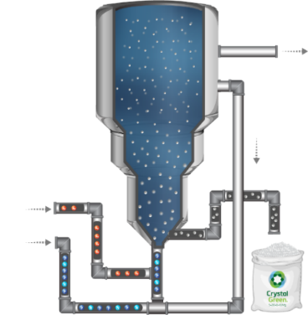
Ostara Technology: The Pearl® Reactor
TREATED EFFLUENT
RECYCLE LINE
MAGNESIUM
POST-DIGESTION DEWATERING LIQUOR + WASSTRIP® FEED
CRYSTAL GREEN
Notes:
We have talked about Ostara’s recovery solution which is a combination of Pearl and Wasstrip.
This picture shows a schematic of what is happening in the pearl reactor. You have nutrient rich influent and wasstrip feed that comes into the bottom of the fluidized bed upflow reactor.
Chemicals are added to create ideal reaction conditions with supersaturated magnesium at the proper pH.
Reactor contents are recycled and treated effluent flows from the top of the reactor.
Periodically an operator will start a harvest cycle to harvest Crystal Green.

Slide 10
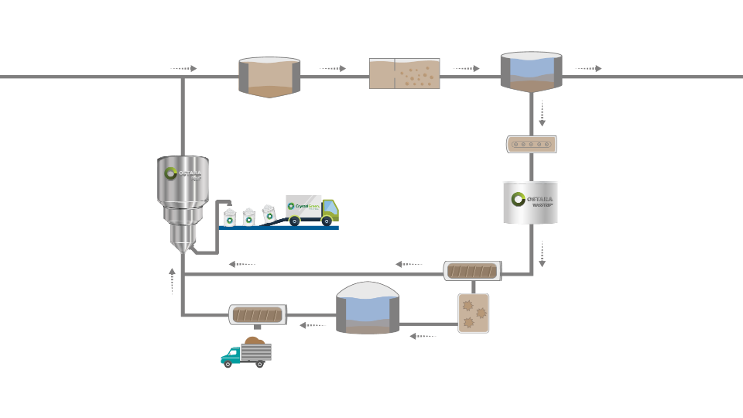
Pearl® + WASSTRIP® Advanced Digestion Integration
PRIMARY
ACTIVATED SLUDGE
SECONDARY CLARIFICATION
INFLUENT
DISCHARGE
THICKENING
PEARL®
Recovers high value fertilizer and reduces recycle P load
WASSTRIP®
Mitigates struvite in digester
DEWATERING
High PO₄ and Mg
High PO₄ and NH₃
DEWATERING
ANAEROBIC DIGESTION
THP
BIOSOLIDS
Notes:
Biological nutrient removal efficiently and effectively reduces effluent nutrient concentration by using an aerobic and an anaerobic zone in the activated sludge process, this causes special bacteria called phosphorus accumulating organisms or PAOs to grow. These bugs take extra phosphorus into their cell walls in aerobic environments so that in the anaerobic zone they can use the P to consume VFAs (volatile fatty acids) in the anaerobic zone. This reduces the effluent phosphorus leaving the facility.
However when the waste activated sludge that his high in P, N, Mg, and K goes into the anaerobic digester, the P is released. This dissolved P is often returned to the head of the plant with the dewatering centrate or it can cause accidental struvite formation.

Slide 11
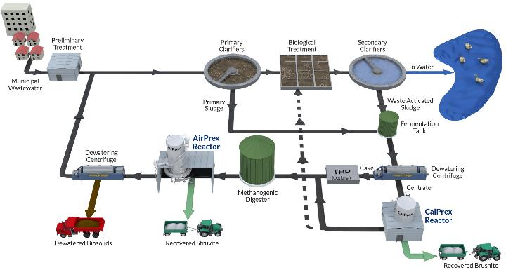
CNP Pre and Post Digestion P Recovery

Slide 12
CalPrex™ P Recovery
Fermentation P-Release
P- enriched Centrate
CalPrex Reactor
P- reduced Centrate with high VFA
Brushite
CaHPO₄ ·2H₂O
Methanogenic Digester
Carbon Supplement for Biological Nutrient Removal

Slide 13
AirPrex® P-Recovery
Methane
Digester
Digested sludge with high PO4-P
Digested sludge with low PO4-P
Struvite
NH₄MgPO₄· 6H₂O

Slide 14
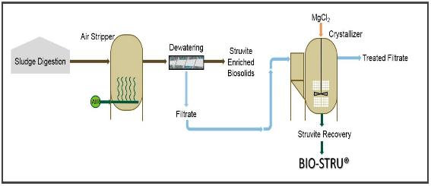
Schwing Bioset NuReSys
Three primary configurations: Hybrid
Air Stripper has 2-hr HRT; Crystallizer has 1-hr HRT
PO4-P levels down to ~15 ppm regardless of starting concentration
Prevents scaling in upstream equipment AND centrate lines
Harvest 90+% of struvite produced w/ optional cyclone
Same lower MgCl₂ dose as centrate option
Can convert Digestate to Hybrid configuration in future
Does not help dewatering performance as MgCl₂ added downstream

Slide 15
Conventional P Mass Balance
Wastewater Treatment Plant Influent
100
Final Effluent
10
Primary Sludge
10
Anaerobic Digestion
90
Biosolids
85
Waste Activated Sludge
80
With no other exit, P mass is removed in biosolids through:
chemical sequestration
unintentional struvite formation
biomass accumulation
Headworks / Recycle
<5

Slide 16
P Balance with Side Stream Recovery
Wastewater Treatment Plant Influent
100
Final Effluent
10
Primary Sludge
10
Anaerobic Digestion
90
Biosolids
75
Waste Activated Sludge
80
Side stream recovery converts approximately 15% percent of influent phosphorus into marketable P fertilizer product.
Phosphorus Recovery ~20
Headworks / Recycle
<5

Slide 17
P Balance with Combined System
Wastewater Treatment Plant
100
Final Effluent
10
Primary Sludge
10
Anaerobic Digestion
60
Biosolids
45
Waste Activated Sludge
80
WASSTRIP
80
Converts Approximately 40% Of Influent Phosphorus Into Extracted Fertilizer Product
Pearl
45
Crystal Green
40
Headworks
5

Slide 18
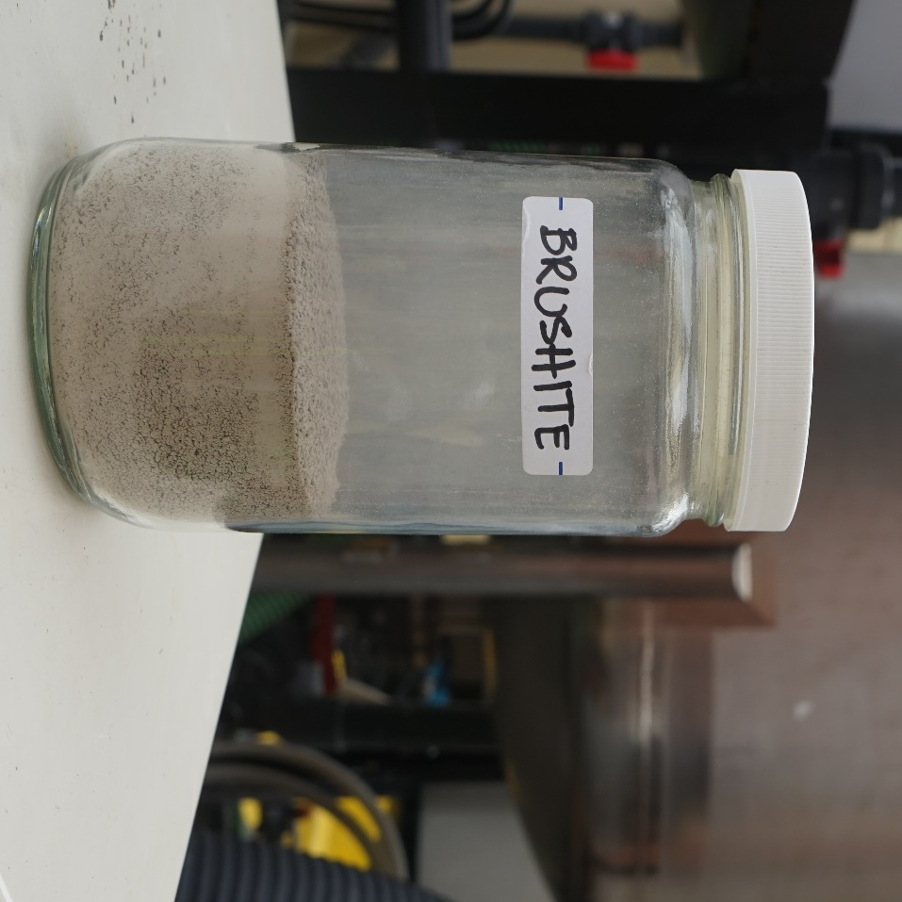
P Mass Balance with CNP Pilot
*Averages of 8 mass balance samplings based on field testing by CNP engineers
Validation Criteria | Target Value | Average Field Value
Solubilization of P in Bio-P Sludge | at least 60% | 66%
Soluble P in CalPrex™ Reactor | 50-100 mg/L | 50 mg/L
Reduction of Total P in Biosolids | up to 50% | TBD*
87%
of the ortho-P entering the reactor was precipitated
92%
particulate capture rate in clarifier
average recovery of ortho P that could otherwise precipitate as struvite downstream
65%
43%
average recovery of total P from sludge feed

Slide 19
Case Studies – Ostara
HRSD Nansemond Plant,
Madison, WI
Clean Water Services, OR
MWRD Greater Chicago Stickney Plant
Gwinnett County GA
Atlanta, GA
19 others in North America

Slide 20
Case Studies – CNP AirPrex
Howard County DPA
Denver Metro
European Reference Facilities

Slide 21
Case Studies – Schwing NuReSys
Tucson, AZ
Grand Rapids, MI

Slide 22
Other Extraction Technologies
Renewable Nutrients – “Quick Wash”: Project development at stand-alone food digester in NE US and at WRRF in mid-West
Thermal Process Systems – “Targeted P Removal”: Pilot plant in Indiana
Absorbents -

Slide 23
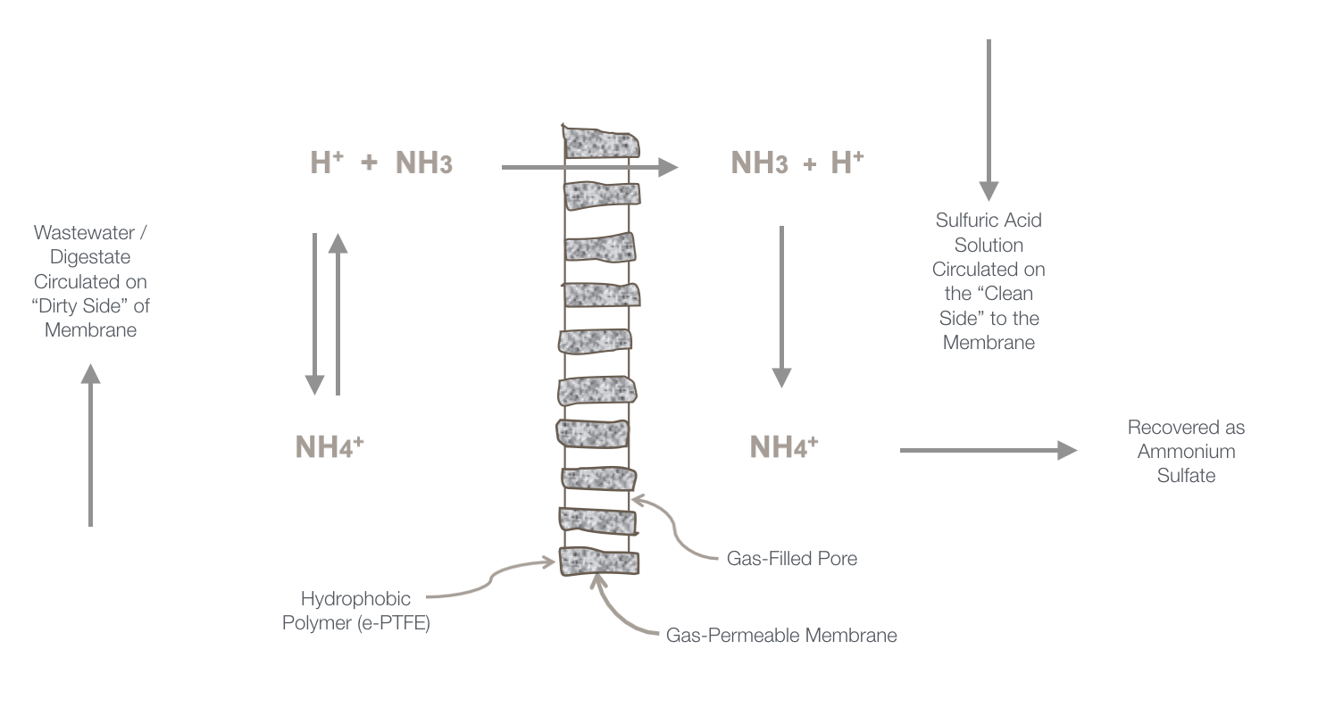
Renewable Nutrients Quick Wash
Using both P extraction and Nitrogen extraction approaches for digestate or filtrate, or combined treatment

Slide 24
Thermal Process System
Enhanced Biological Nutrient Removal
Phosphorus uptake by bacteria
Low P Return
Low P Return
Acid Phase Digester
Acid hydrolysis
Phosphorus Release
Denitrification
ATAD
Thermal hydrolysis
Phosphorus Release
VS & COD Destruction
Anaerobic Digester
VS & COD Destruction
SNDR
Nitrification/Denitrification
EPS Reduction
Alkalinity Reduction
SGR
Nitrification
EPS Reduction
Alkalinity Reduction
TPR
Dewatering
TPR
Dewatering
Low P Cake P Product
Low P Cake P Product
Notes:
Conditioning criteria present in the pilot systems

Slide 25
Case Study – SSI Ash
German Policy Directive: example, TetraPhos from Remondis Aqua, wet chemical extraction of P from SSI Ash; also EasyMining Sweden, and Outotech GmbH.
Direct Use of SSI Ash for P fertilization: NEORSD Southerly, Cleveland, OH (Nick Basta, The Ohio State University); Metro Council Environmental Services, Minneapolis, MN (Persephone Ma, University of Minnesota)

